Slide 1
DNA footprinting
Brendan Kearney

Slide 2
What is footprinting?
A “simple method for assessing the sequence selectivity of DNA-binding ligands” (Hampshire, 2007)
Protection assay
Notes:
A method of looking at the interaction of certain DNA strands and proteins that bind to it

Slide 3
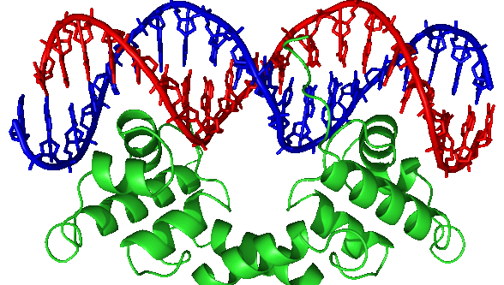
DNA-protein interactions
Occur in vital processes within cells (Gromiha, 2013)
Regulation of gene expression
DNA replication and repair
Transcription
Packaging
Other techniques
Chromatin Immunoprecipitation assay (ChIP)
Electrophoretic mobility shift assay (EMSA)
1
Notes:
As we know, a lot of crucial proteins interact with DNA in cell processes
Regulation, inhibition, synthesis of new DNA, RNA, eventually proteins through transcription
Packaging into histone and chromosome structures

Slide 4
Basis of footprinting
Proteins bind to DNA at specific locations (Galas and Schmitz, 1978)
These proteins protect those DNA fragments from cleavage or degradation from external agents.
Compared to proteinless DNA, DNA fragments containing protein will be protected from cleavage
Difference can be visualized on polyacrylamide gel
Notes:
Footprinting - determination of where proteins bind to DNA

Slide 5
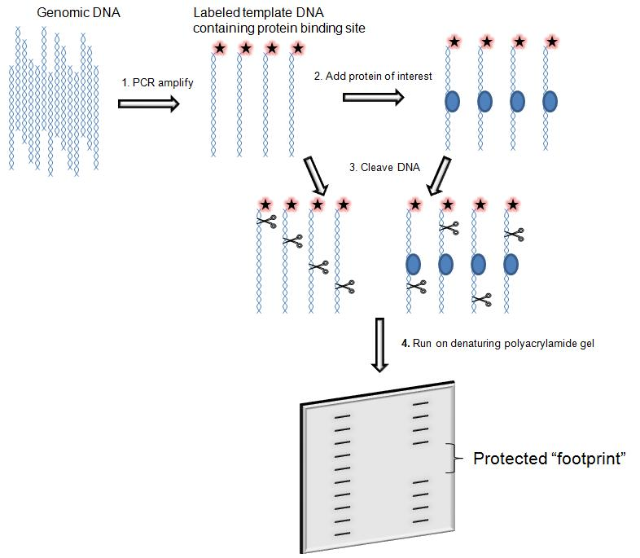
DNA footprinting process
2
Notes:
General schematic

Slide 6
Other applications
Quantitative footprinting - estimating the binding strength of certain interactions by modifying protein concentrations (Hampshire, 2007)
in vivo footprinting - usage of UV radiation to cleave DNA inside cells.

Slide 7
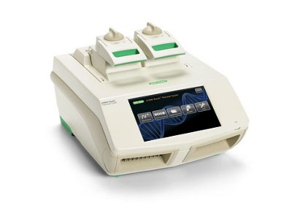
Methods
PCR amplification - DNA fragment of interest (100-400 bps) from genomic source or a plasmid is amplified
DNA labeling - ³²P label at the 5’ or 3’ end of DNA fragment. Labeled primer is added directly during PCR reaction.
DNA purification - Unwanted probes are removed from fragments using columns or ethanol solution
3

Slide 8
Methods - protein and cleavage agents
Protein addition - purified protein corresponding to site of interest is bound to DNA via immunoprecipitation
Control fragment without protein is also created
Cleavage agent - mixing of radiolabeled DNA and cleavage agent in solution
Selection dependent on ability to randomly cleave DNA
DNase I
Hydroxyl radicals
UV light

Slide 9
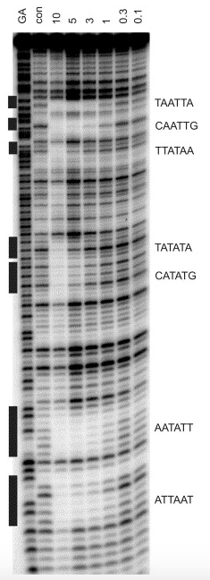
SDS-PAGE analysis
Image - Quantitative footprinting patterns showing the interaction of Hoechst 33258 with HexB universal footprinting fragments. (Hampshire, 2007)
GA - marker for purines
con - control without protein ligand added
The ligand concentration (μM) is shown at the top of each gel lane
Notes:
Hoechst stains are part of a family of blue fluorescent dyes used to stain DNA

Slide 10
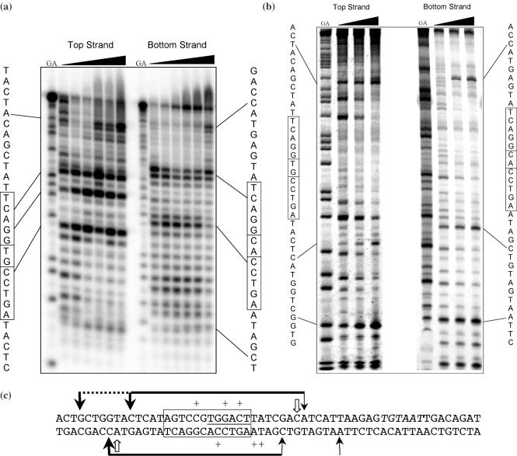
Application: Determination of C.AhdI binding site
AhdI R-M system: encodes for three genes
C.AhdI binding site - found 30 bp upstream of ahdI operon
12 bp sequence - AGTCCGTGGACT
(a) - Exonuclease III
(b) - DNase I
GA - G + A sequencing ladder
(Streeter et al. 2004)

Slide 11
Relation to our lab
Apoptosis - programmed cell death
Detected by his-tagged annexin V, which binds to PS
Hallmark of apoptosis - DNA fragmentation
Endogenous endonucleases (DNase)
Notes:
shrinkage of the cell, fragmentation into membrane-bound apoptotic bodies and rapid phagocytosis

Slide 12
Credits
Gromiha MM, Naharajan R. Chapter Three - Computational Approaches for Predicting the Binding Sites and Understanding the Recognition Mechanism of Protein–DNA Complexes. Adv Protein Chem Str. 2013; 91:65-99.
Hampshire AJ1, Rusling DA, Broughton-Head VJ, Fox KR. Footprinting: a method for determining the sequence selectivity, affinity and kinetics of DNA-binding ligands. Methods. 2007;42(2):128-40.
Galas DJ, Schmitz A. DNAse footprinting: a simple method for the detection of protein-DNA binding specificity.
Streeter SD, Papapanagiotou I, McGeehan JE, Kneale GG. DNA footprinting and biophysical characterization of the controller protein C.AhdI suggests the basis of a genetic switch. Nucleic Acids Res. 2004;32(21):6445-6453.

Slide 13
Image Sources
http://biopundit.com/high-throughput-platform-to-explore-rna-protein-interactomes/
https://en.wikipedia.org/wiki/File:Courtney_2008.jpg
https://www.biocompare.com/Nucleic-Acid-Electrophoresis/23398-Thermal-Cyclers-Thermocyclers-PCR-Machine/
https://www.ncbi.nlm.nih.gov/pubmed/17472895
https://www.ncbi.nlm.nih.gov/pmc/articles/PMC535683/

